Slide 1
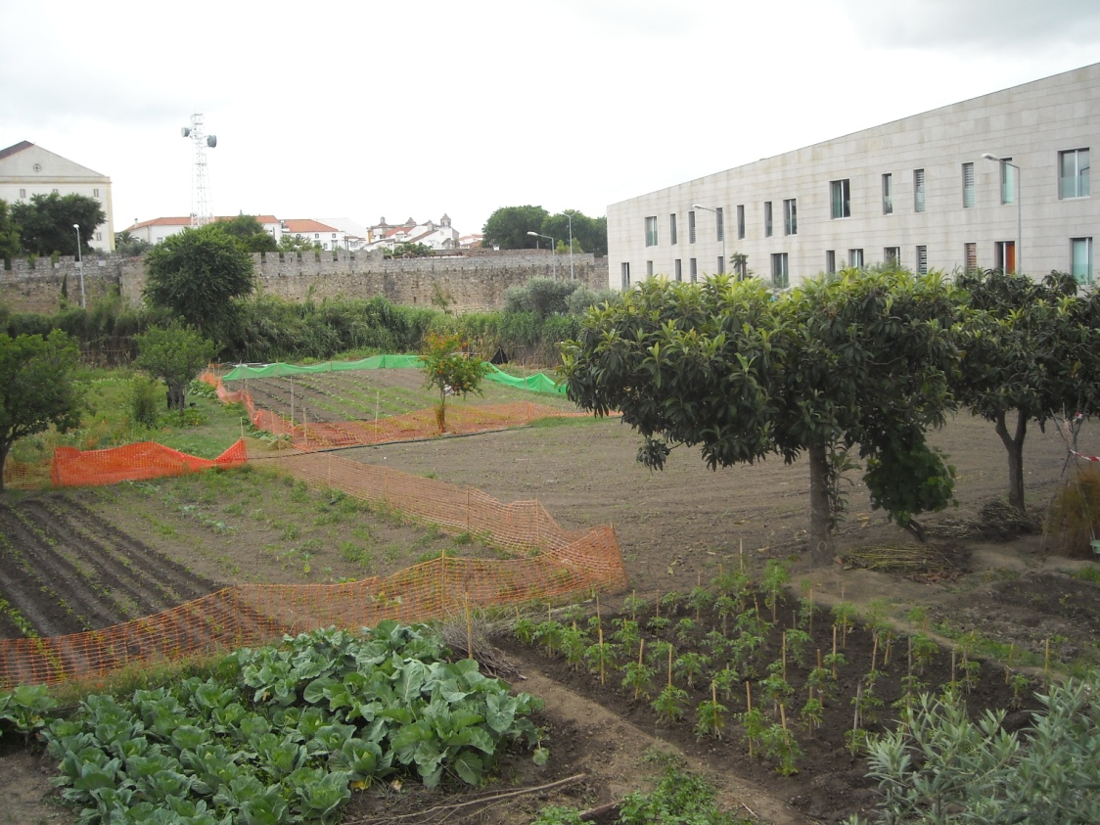

Allotment Gardens – A Valuable Ecosystem Service
Rute Sousa Matos
CHAIA – University of Évora - Portugal

Slide 2
Allotment Gardens - A Valuable Ecosystem Service
Why the study of allotment gardens?
Because agricultural/horticultural practice in the urban space is a way to establish a relationship between production, protection and recreation.
Because its a core activity on the energy and food crisis that we live and that is expected to be worse in the future.

Slide 3
Allotment Gardens - A Valuable Ecosystem Service
Why consider allotment gardens an ecosystem service?
Because, like an allotment garden , an ecosystem is a dynamic complex of plant, animal and micro-organism communities and the nonliving environment interacting as a functional unit. People are integral parts of ecosystems.
The “ecosystem services,” are the benefits that people obtain from ecosystems, particularly the linkages between ecosystems and human well-being.

Slide 4
Allotment Gardens - A Valuable Ecosystem Service
Why are allotment gardens an ecosystem service?
Ecosystem services , just like allotment gardens, include the following:
Provisioning services, such as providing food, water, timber and fibre;
Regulating services, such as the regulation of climate, floods, disease, wastes and water quality;
Cultural services, such as offering recreational, aesthetic, and spiritual benefits;
Supporting services, such as soil formation, photosynthesis, and nutrient cycling

Slide 5
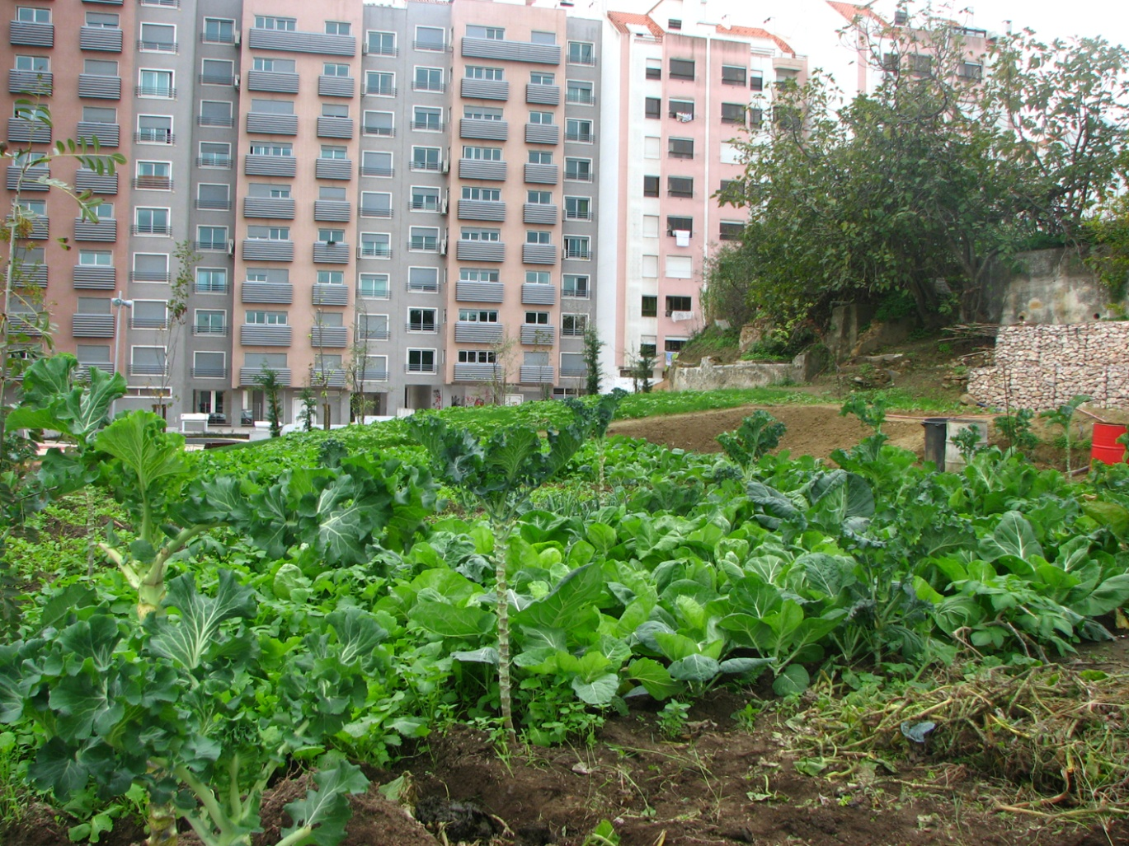
Allotment Gardens - A Valuable Ecosystem Service
The benefits of allotment gardens
The allotment gardens are a unique contribution to the cityscape. They challenge the conventional notion of urban space and design of open spaces, because they are “in growing” and productive urban spaces. They are na echo, a memory of what the country side has been – a humanized landscape, still accessible in the heart of the city.

Slide 6
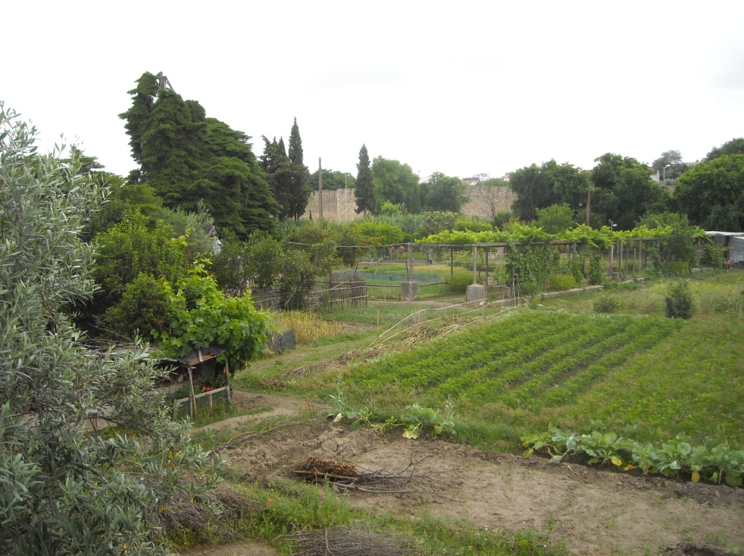
Allotment Gardens - A Valuable Ecosystem Service
The benefits of allotment gardens
The benefits of these spaces are multifaceted:
Socially
Environmentally
Humanly
Economically
Emotionally
Aesthetically

Slide 7
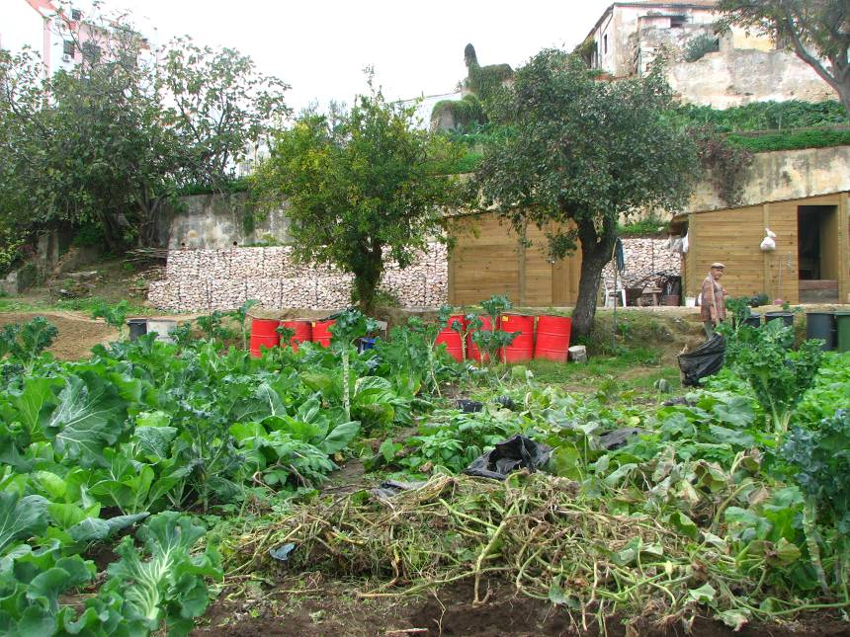
Allotment Gardens - A Valuable Ecosystem Service
The benefits of allotment gardens
These spaces have all that the city and the man need from nature, including the understanding of the landscape mulfunctionality

Slide 8
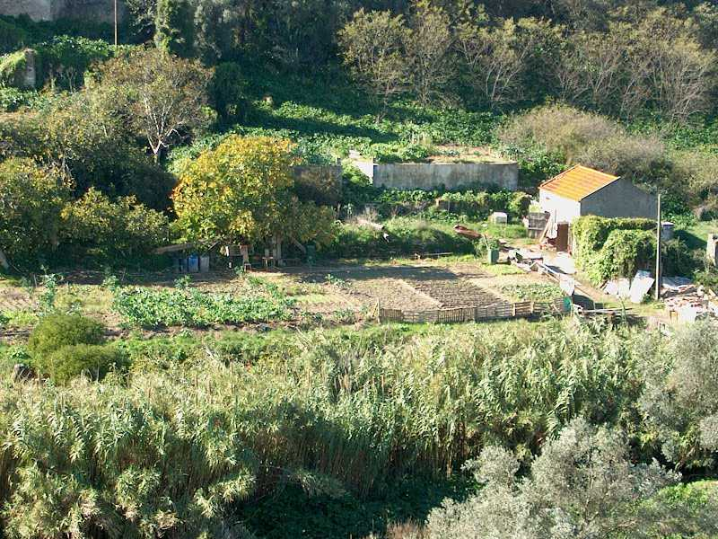
Allotment Gardens - A Valuable Ecosystem Service
Objectives
Our aim is the inclusion of the allotment gardens in a new design approach to the city’s open spaces, improving the efficiency of multifunctional land uses and their articulation trough structural and human interfaces.

Slide 9
Allotment Gardens - A Valuable Ecosystem Service
Objectives
…The creation of a productive and recreational landscape infrastruture that will assure the link and the articulation with the several open spaces of the city and the connection between them and the countryside.

Slide 10
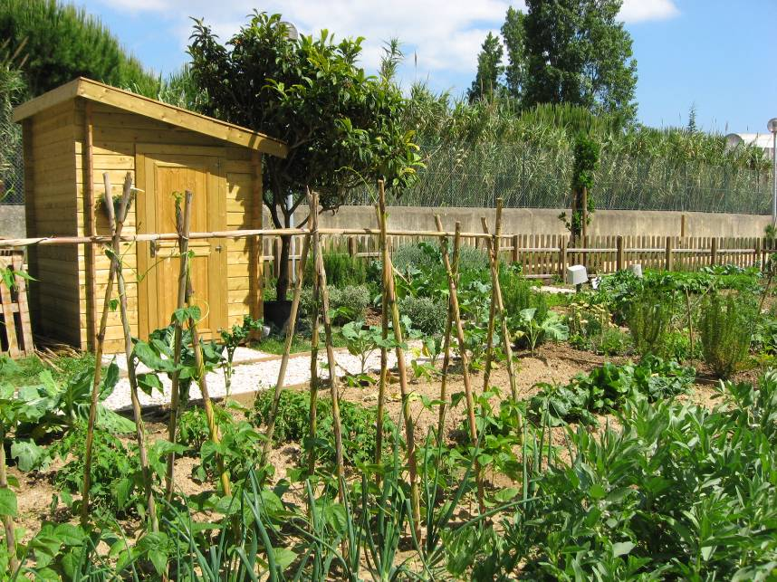
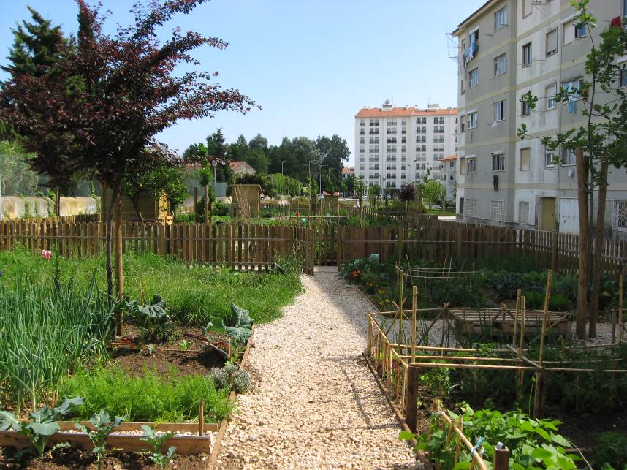
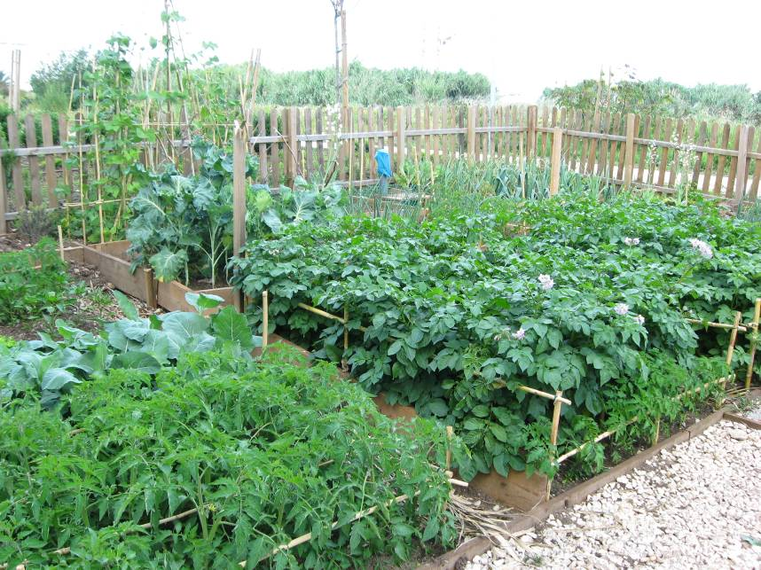
Allotment Gardens - A Valuable Ecosystem Service
Case-study – the metropolitan area of Lisbon
Allotment gardens using organic farming – Municipality of Cascais

Slide 11
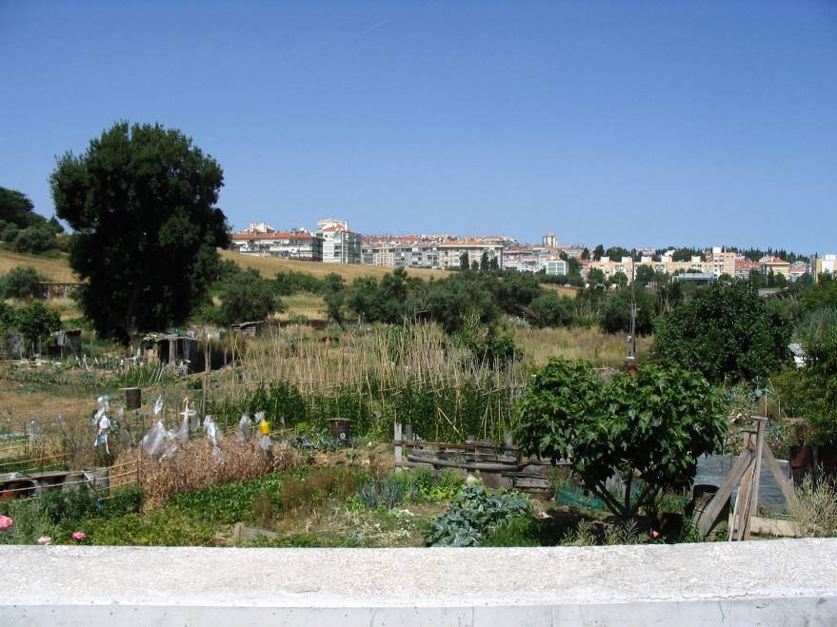
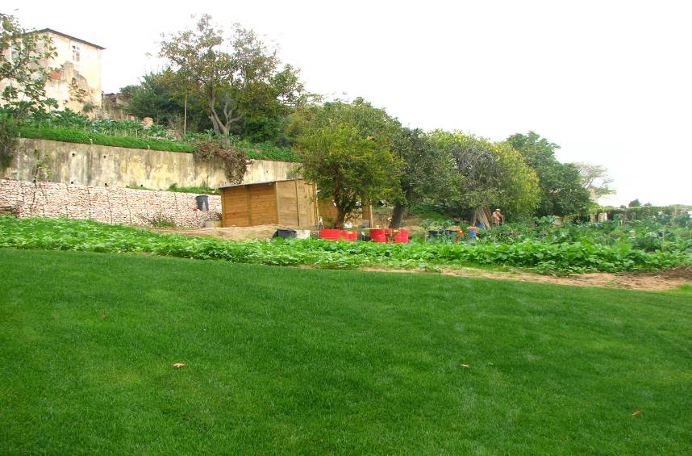
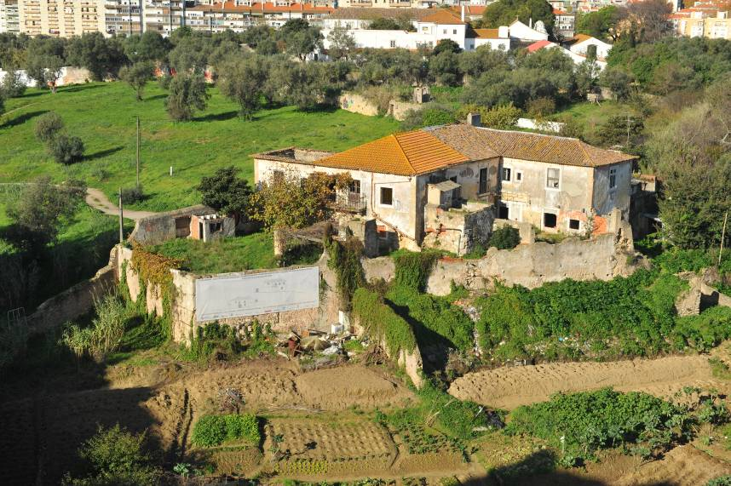
Allotment Gardens - A Valuable Ecosystem Service
Case-study – the metropolitan area of Lisbon
Allotment Gardens – “Quinta da Granja”

Slide 12
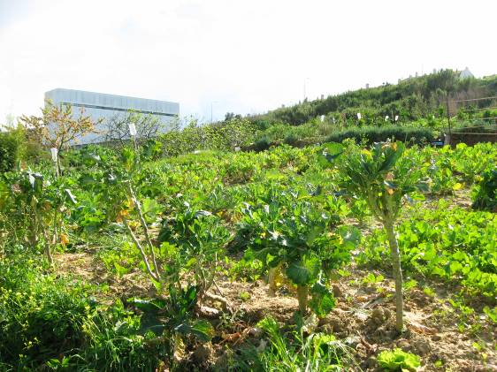
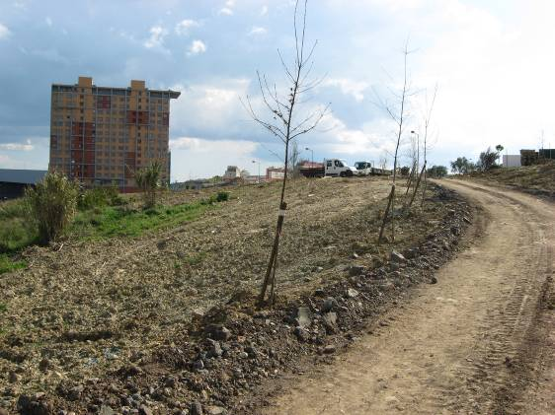
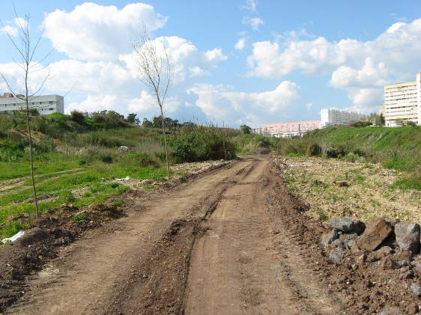
Allotment Gardens - A Valuable Ecosystem Service
Case-study – the metropolitan area of Lisbon
Allotment Gardens – Vale de Chelas

Slide 13
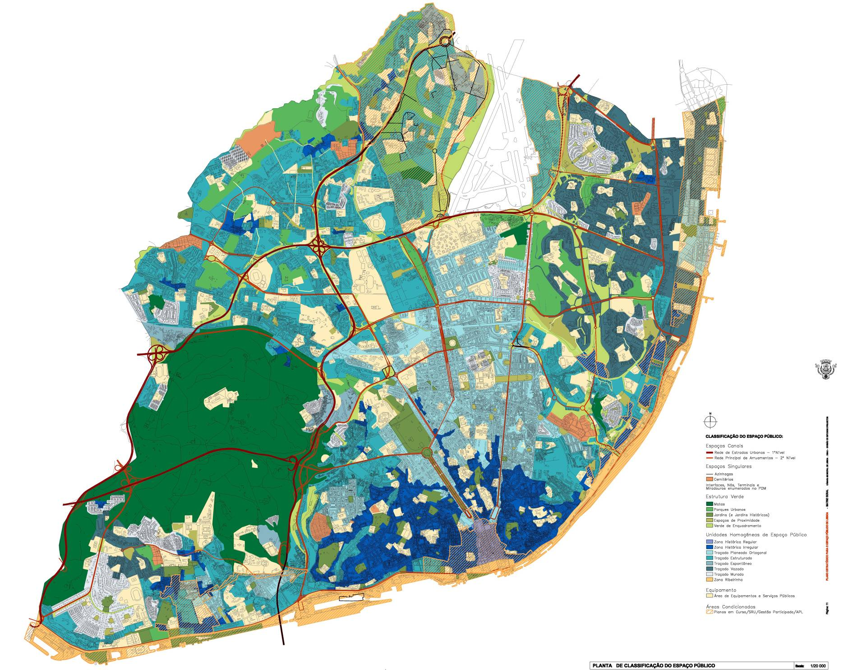
Allotment Gardens - A Valuable Ecosystem Service
Case-study – the metropolitan area of Lisbon
On Lisbon Municipality they are working on new initiatives that promote urban practices of economical, social and environmental sustainability.
Strategic Plan for the public space of Lisbon

Slide 14
Allotment Gardens - A Valuable Ecosystem Service
Increase of the familiar economy
Benefits for the City Hall economy due to the lower costs for maintainace of these spaces
Social integration
Major Benefits for the Public Health both Physical and Psychological
Environmental Benefits due to the balanced maintainance of the Urban Spaces
Expectant municipal areas of temporary occupation
Scattered Allotment Gardens
Allotment gardens
Social allotment gardens
Recreational allotment gardens
Pedagogical allotment Gardens
Areas of the City Master Plan for production and recreation

Slide 15
Allotment Gardens - A Valuable Ecosystem Service
Contribute to a greater environmental sustainability of the city at various levels:
Keeping ecosystems that still exist;
Improve the microclimate by improving air quality by increasing the production of oxygen;
improving soil quality by correcting organic practices and appropriate cultural demonstrations;
proper use of soil water and improving water systems by increasing the permeability of soils.
supply of fresh produce in urban centers.
improving public health awareness and the ability of access to the entire population to the consumption of fresh produce and also by the action of psychological and physical therapeutic of horticulture.
Constitute a factor in the new landscape and environmental areas of spatial organization of lifetime use, mostly degraded, which would not have any jobs
Constitute a factor of cultural sensitivity by raising the population's general craft production systems, bringing the City entertainment to rural populations and provide different recreational activities to the entire urban population.
Awareness of all people of different strata of the importance of fresh food and the nutritional and economic feasibility of organic farming.
General Goals

Slide 16
Allotment Gardens - A Valuable Ecosystem Service
Social and Community Allotment Gardens:
Contribute to the supply of fresh produce for Urban Centers
Function as occupational therapy for the cultivation of land, particularly by people temporarily unemployed or professionally inactive age groups.
Providing an increase in physical well being / economic / social for the possibility of consumption and / or marketing of fresh key products, and the promotion of social interaction between communities.
Contribute to the supply of fresh produce in urban centers.
Provision of means of environmental education that promote the importance of fresh food and the nutritional and economic advantage of organic farming, including specific training in methods of cultivation and waste treatment
Recreational Allotment Gardens for Individual or Collective use:
Contribute to an increase in physical well-being / psychological and the contact with the agricultural practices in professional or non-active population by age or by any physical or mental disabilities.
Contribute to improve the promotion of social relations between individuals of different communities, struggling against isolation and individualism, a characteristic of contemporary urban communities.
Specific objectives
of each type of
allotment garden

Slide 17
Allotment Gardens - A Valuable Ecosystem Service
Pedagogical Gardens
Promoting environmental education activities by information and awareness of organic farming practices and sustainable treatment of waste.
Interaction with people and various organizations / institutions of public interest connecting the "Man on Earth", inherent in the rural areas, as well as education of the conviction and will to protect the environment.
Scattered Gardens
Legitimize the occupation of expectant land for production, until the space provid to be carried out through agreements of temporary occupation.
Valuing environmental / ecological and visual fields.
Contribution to an increase in family income of the population that uses this type of gardens, by the possibility of consumption of fresh food that can not be marketed.
Specific objectives
of each type of
Allotment garden

Slide 18
Allotment Gardens - A Valuable Ecosystem Service
The social or community gardens, gardens for recreational use, in individual or collective gardens and pedagogical gardens fall into municipal land, defined as "Areas of Production" in Lisbon Plan and / or Urban Parks that include areas of allotment gardens, both of Ecological structure in the City Plan.
The scattered Gardens, fall into expectant public land, being conditioned by arrangement with the manager, stopping at the beginning of the implementation of the uses for the pre-defined spaces in question, with prior notice of ,at least, three months to the farmer.
Areas of Implementation

Slide 19
Allotment Gardens - A Valuable Ecosystem Service
Must cultivate the Garden.
Settle the charges incurred in using the garden when existing
Ensure the cleanliness, safety and good use of the horticultural areas and warn the City Hall of any irregularities
Place the solid waste produced in containers available for this purpose or, if not present, to ensure by their means, these products to a suitable place outside the vegetables area.
Use appropriate means of cultivation and use / promote good environmental practices. The practice of organic farming is required, in the case of recreational and educational gardens, also in the social allotment gardens, the latter after being given training in charge of the City Hall.
Respect the subdivision defined by the City Hall when present.
Duties of users

Slide 20
Allotment Gardens - A Valuable Ecosystem Service
Crops grown in the recreational gardens and in the pedagogical gardens only be used for own consumption, except for social fund initiatives to be approved by the City Hall.
Crops grown in social or community gardens may be used for own consumption or integrated into schemes of cooperative production and marketing of fresh produce, organic markets, etc. As long as inspected and approved by the City Hall.
Destination of Products

Slide 21
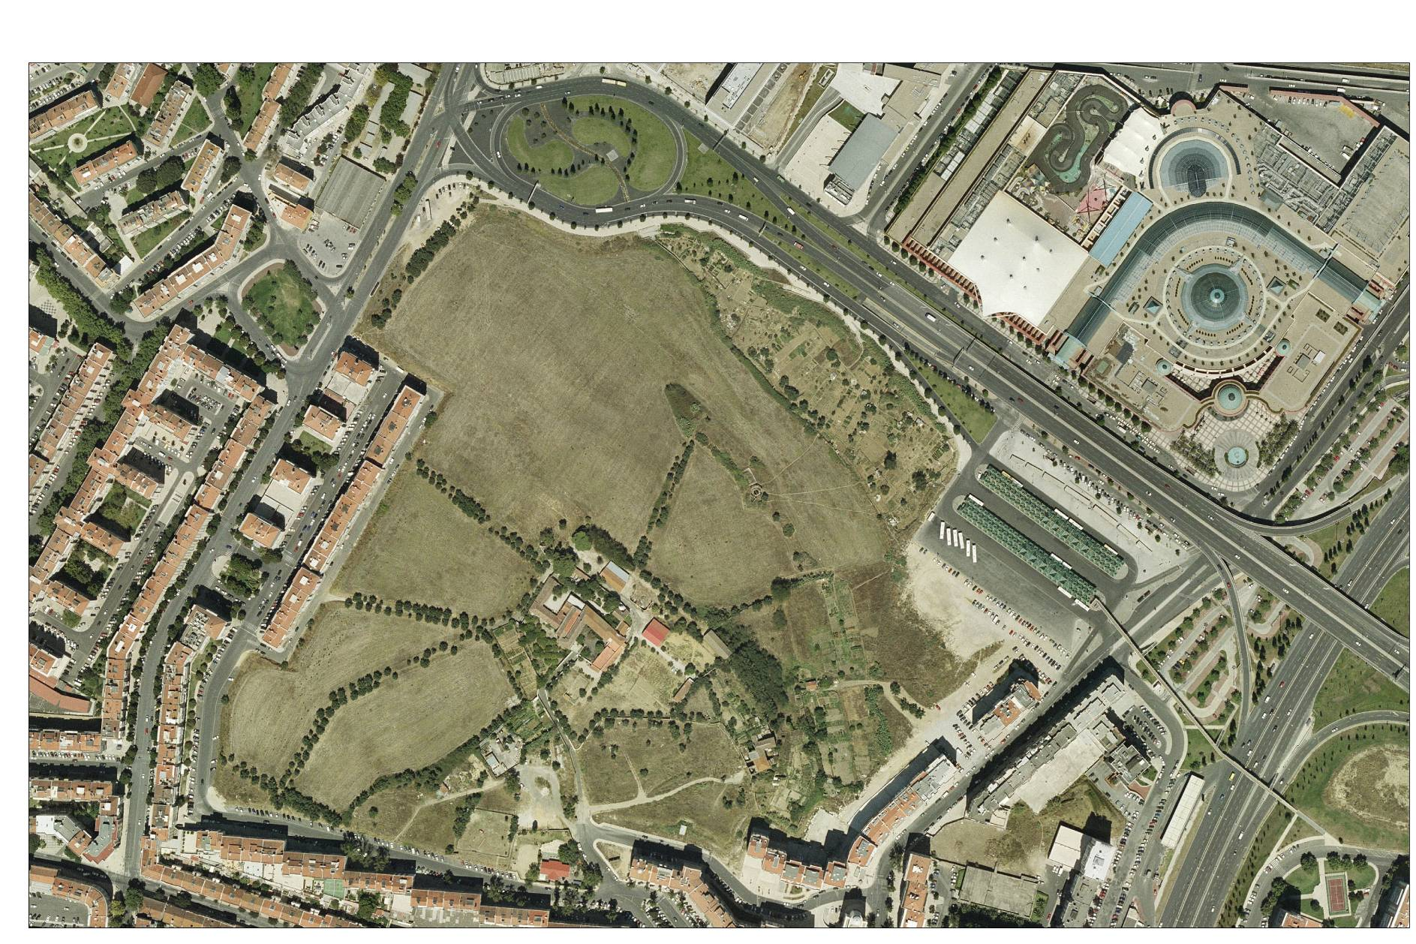
Allotment Gardens - A Valuable Ecosystem Service
Urban parks with areas of allotment gardens included
Quinta da Granja – Original situation – Phase 1

Slide 22
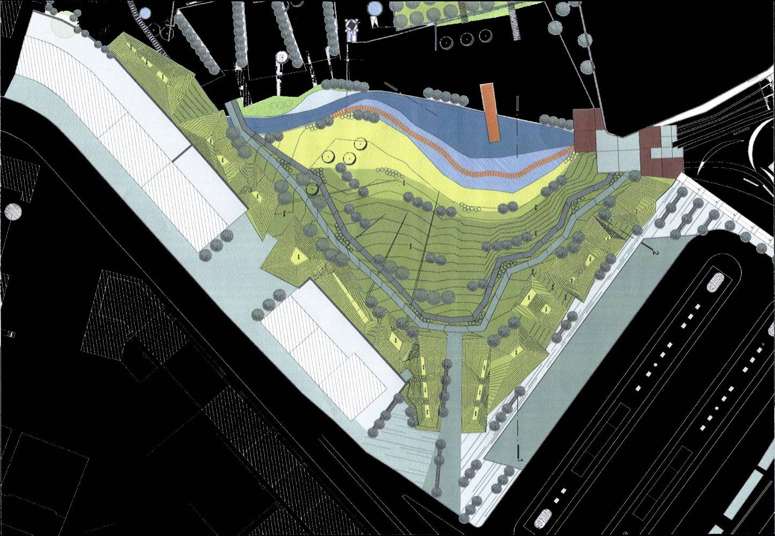
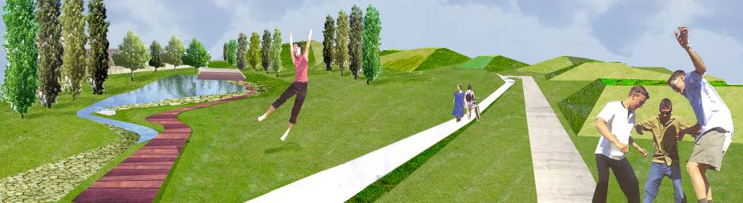
Allotment Gardens - A Valuable Ecosystem Service
Urban parks with areas of allotment gardens included
Quinta da Granja – Urban Park– Phase 1

Slide 23
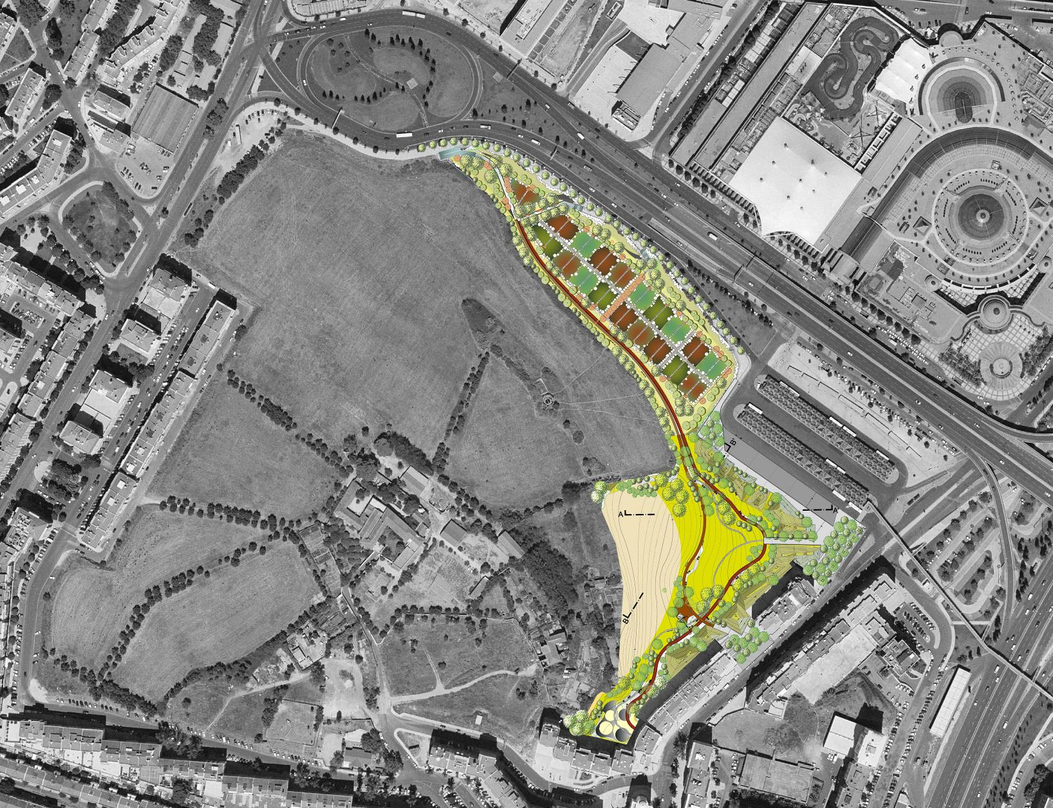
Allotment Gardens - A Valuable Ecosystem Service
Urban parks with areas of allotment gardens included
Quinta da Granja – Urban Park – Inclusion of allotment gardens in the urban park.

Slide 24
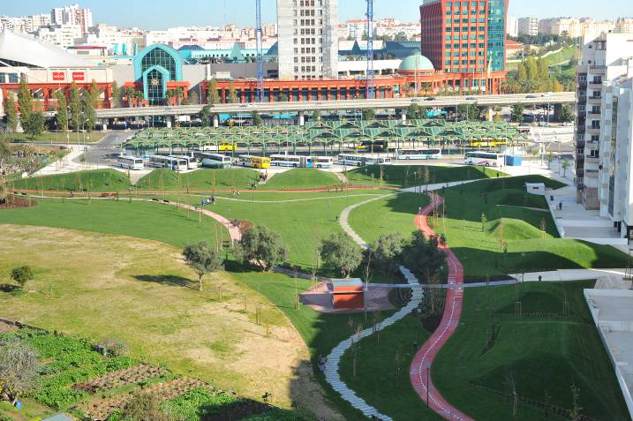
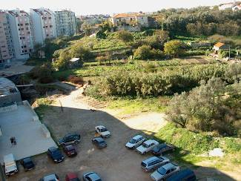
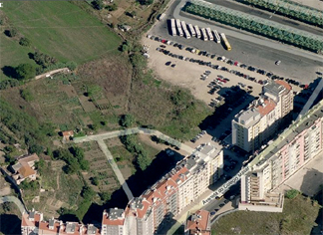
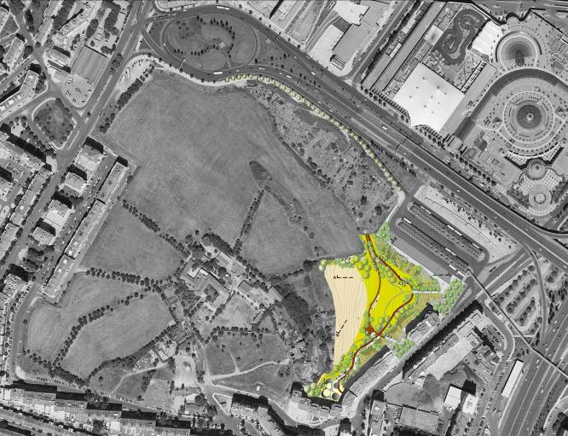
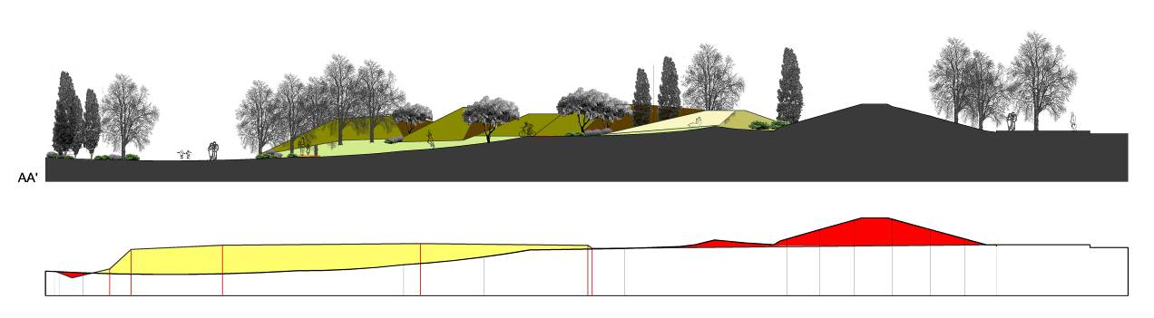
Allotment Gardens - A Valuable Ecosystem Service
Urban parks with areas of allotment gardens included
Quinta da Granja – Urban Park – pathways and corridors

Slide 25
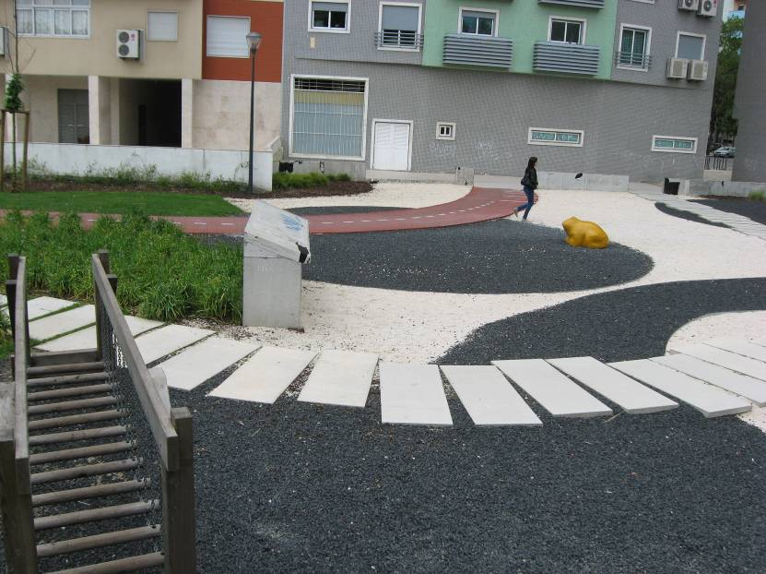
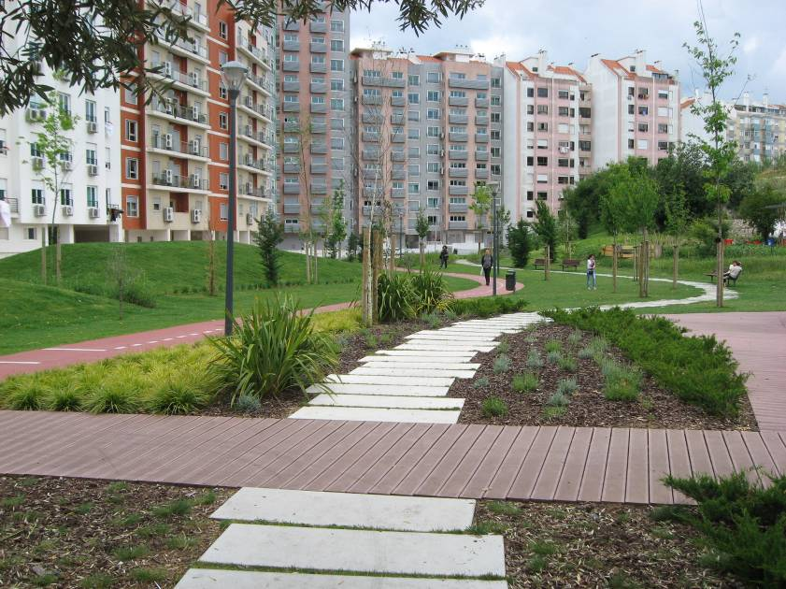
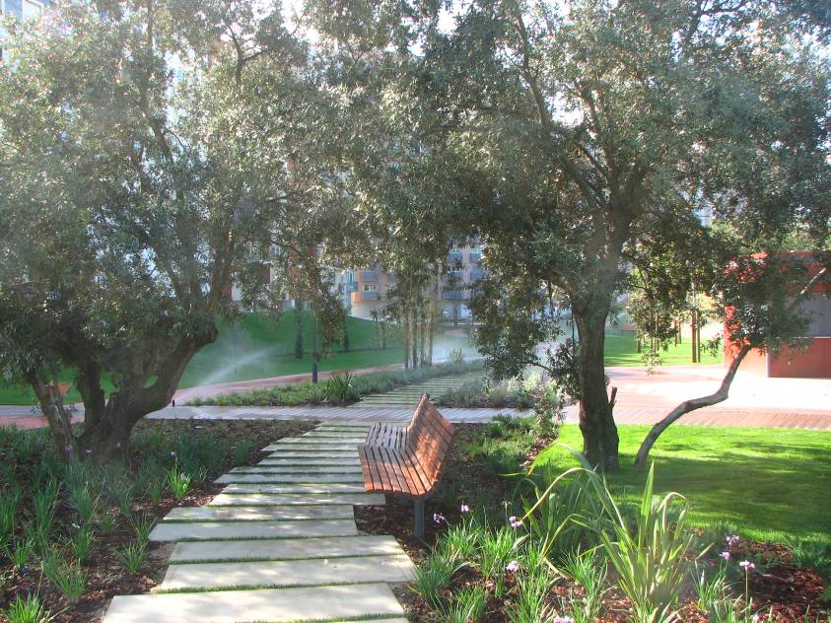
Allotment Gardens - A Valuable Ecosystem Service
Urban parks with areas of allotment gardens included
Quinta da Granja – Urban Park – pathways and corridors

Slide 26
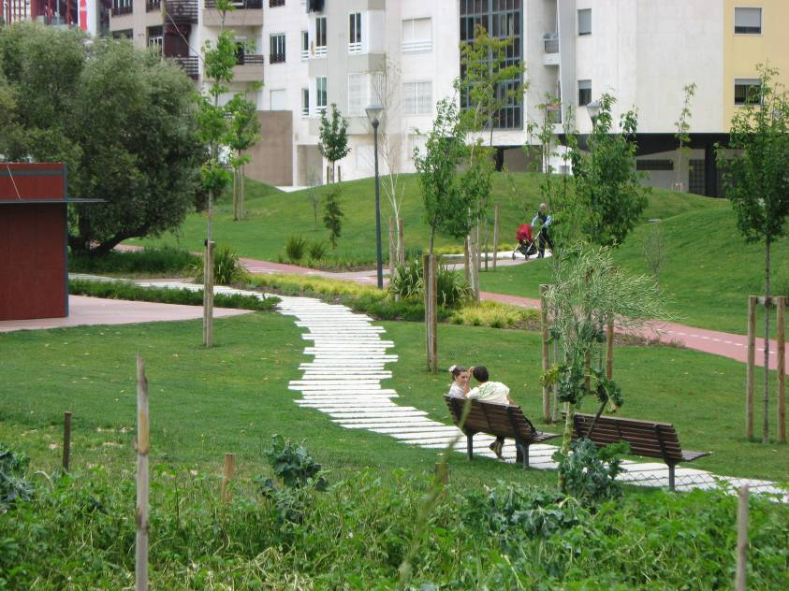
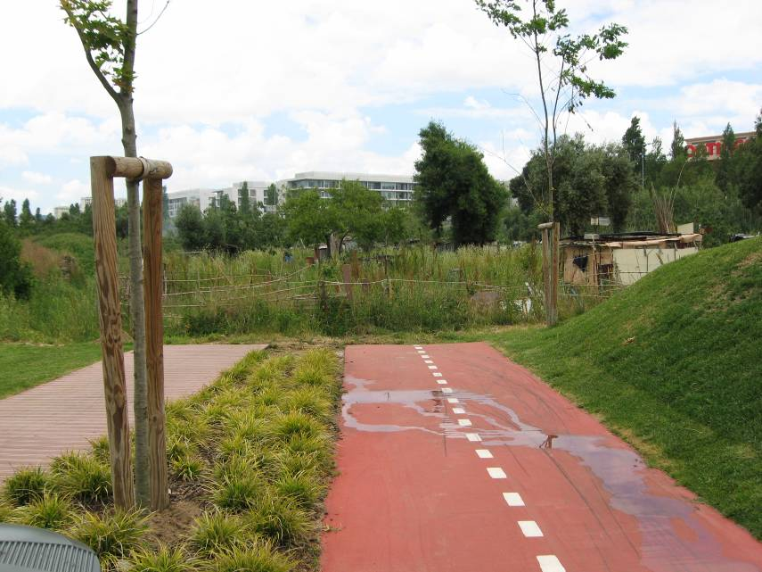
Allotment Gardens - A Valuable Ecosystem Service
Urban parks with areas of allotment gardens included
Quinta da Granja – Urban Park – pathways and corridors

Slide 27
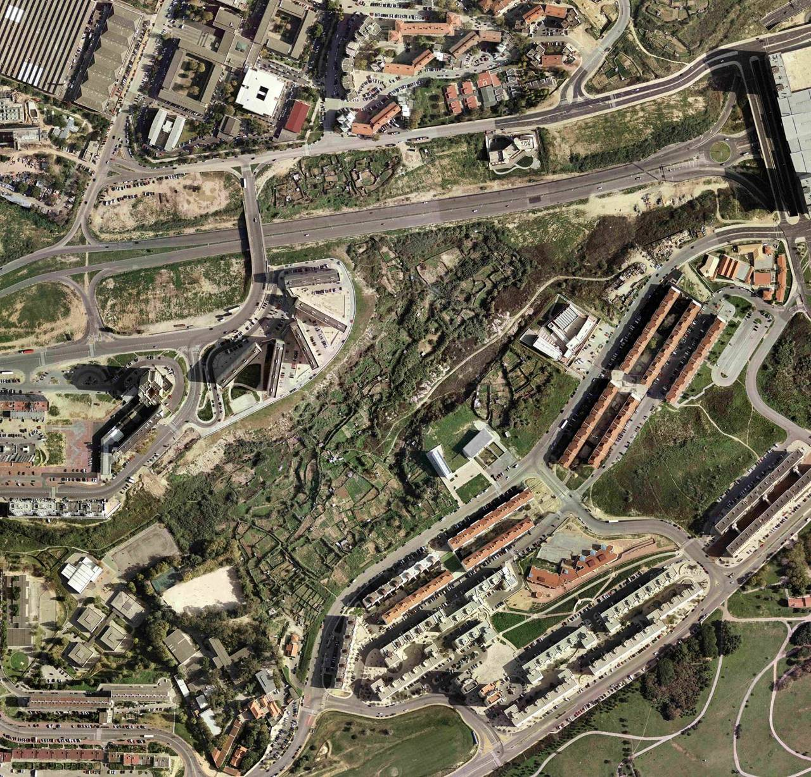
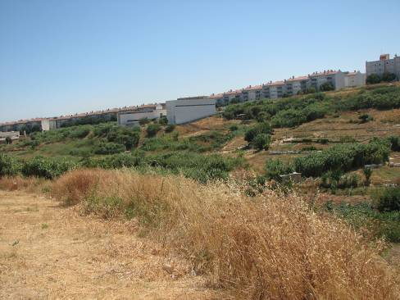
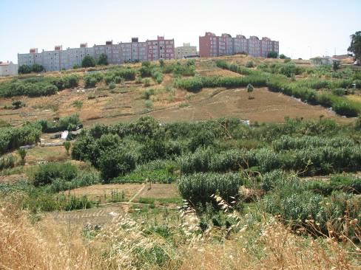
Allotment Gardens - A Valuable Ecosystem Service
Urban parks with areas of allotment gardens included
Agrarian Park of Vale de Chelas

Slide 28
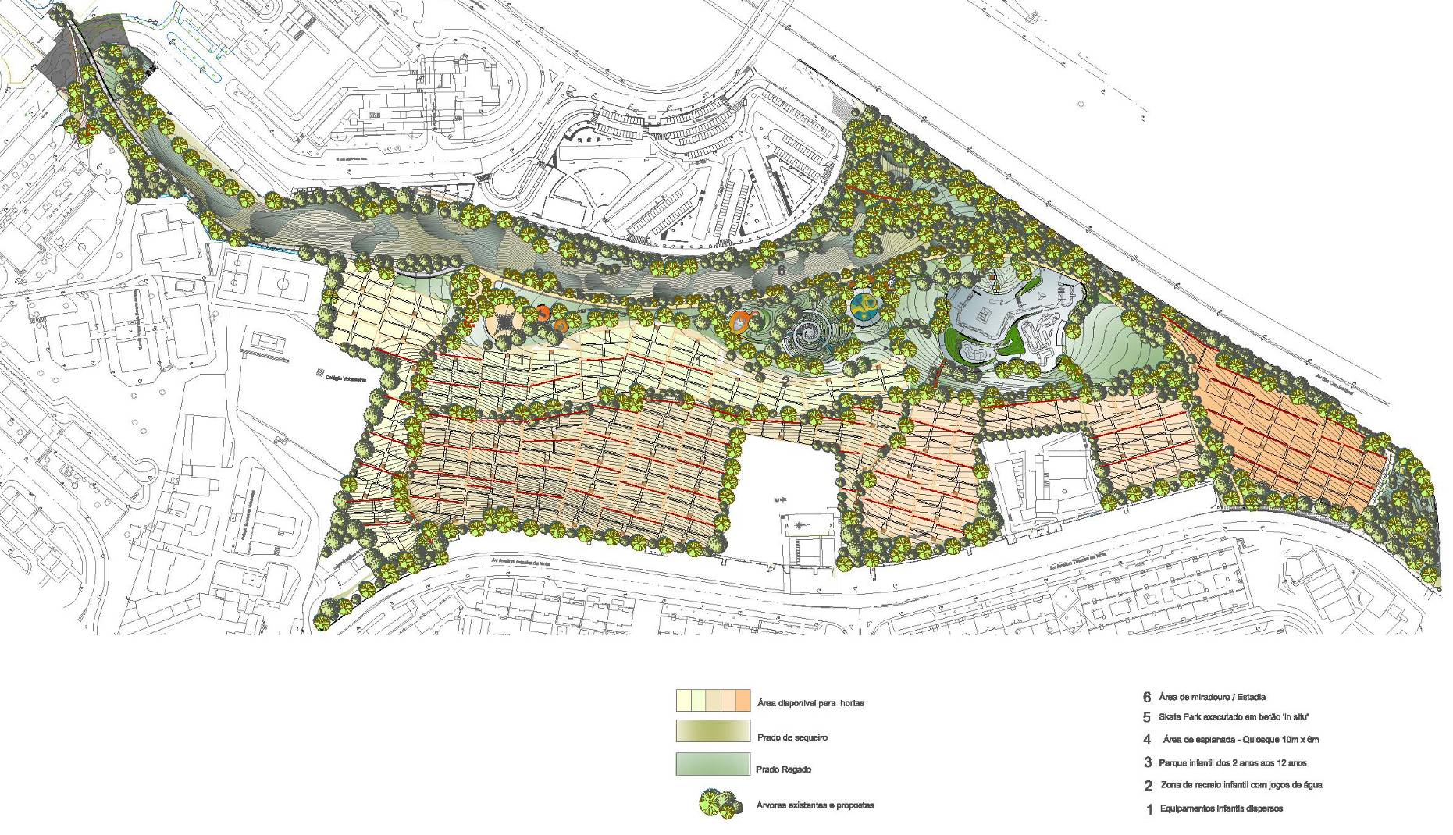
Allotment Gardens - A Valuable Ecosystem Service
Urban parks with areas of allotment gardens included
Agrarian Park of Vale de Chelas - Masterplan

Slide 29
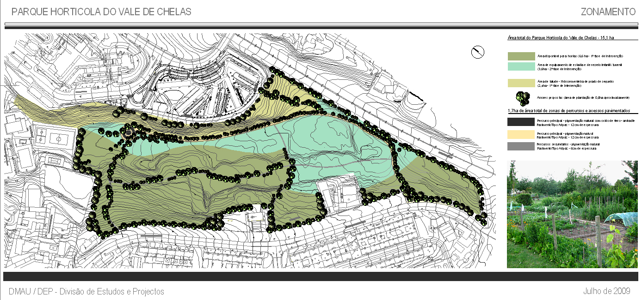
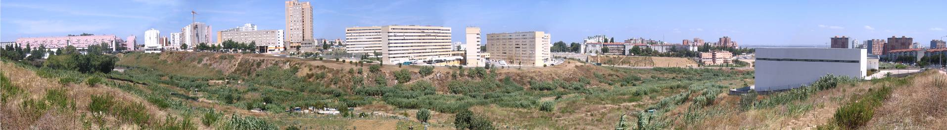
Allotment Gardens - A Valuable Ecosystem Service
Urban parks with areas of allotment gardens included
Agrarian Park of Vale de Chelas - Phasing

Slide 30
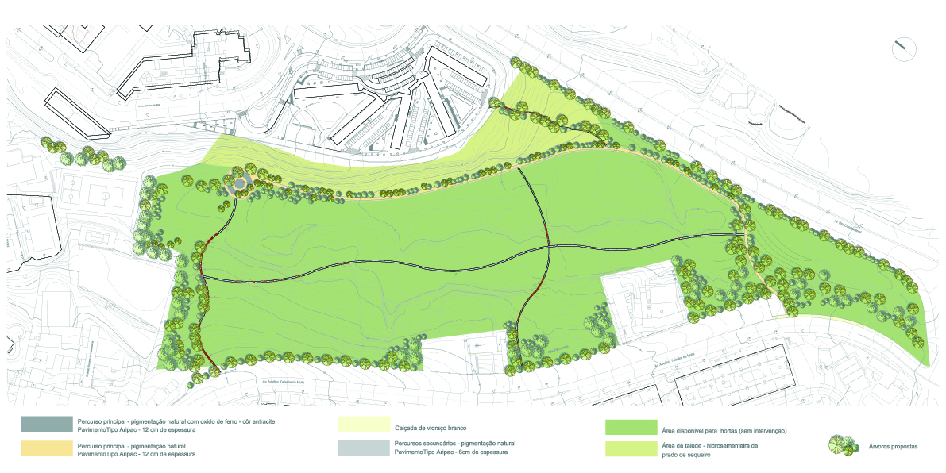
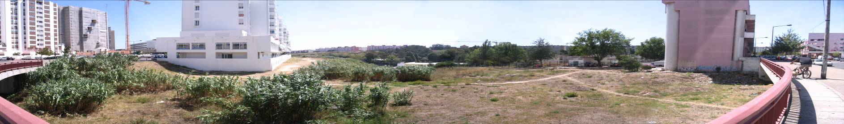
Allotment Gardens - A Valuable Ecosystem Service
Urban parks with areas of allotment gardens included
Agrarian Park of Vale de Chelas – Primary and secondary pathways of access to the allotment gardens

Slide 31
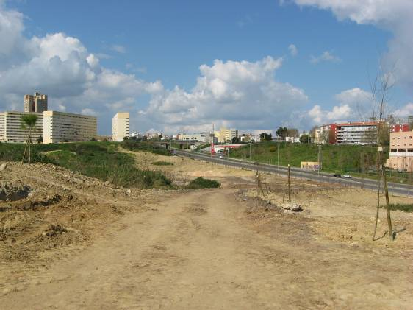
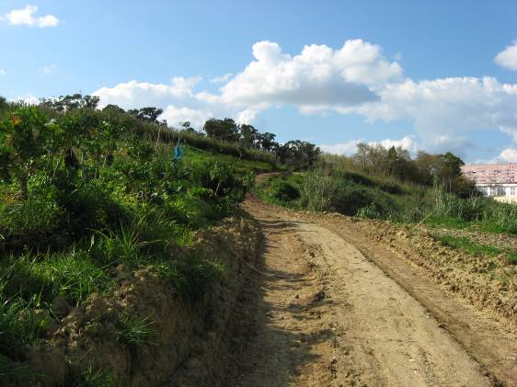
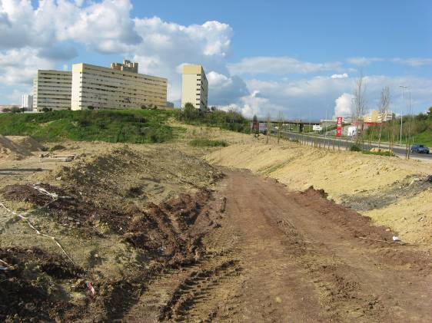
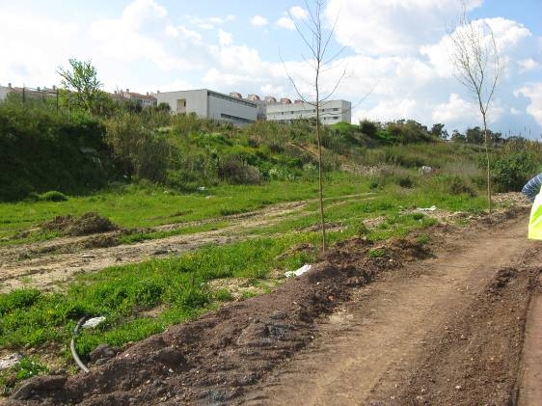
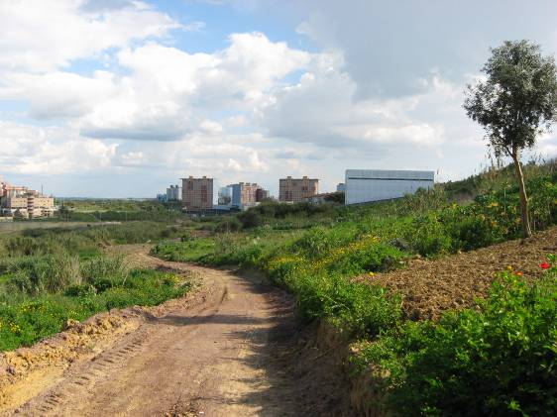
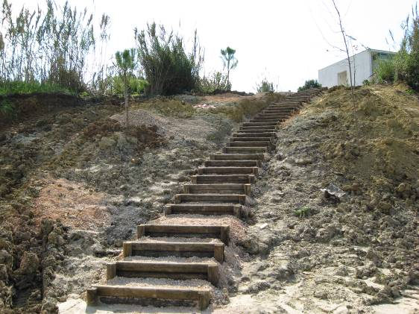
Allotment Gardens - A Valuable Ecosystem Service
Urban parks with areas of allotment gardens included
Agrarian Park of Vale de Chelas – Images of the work

Slide 32
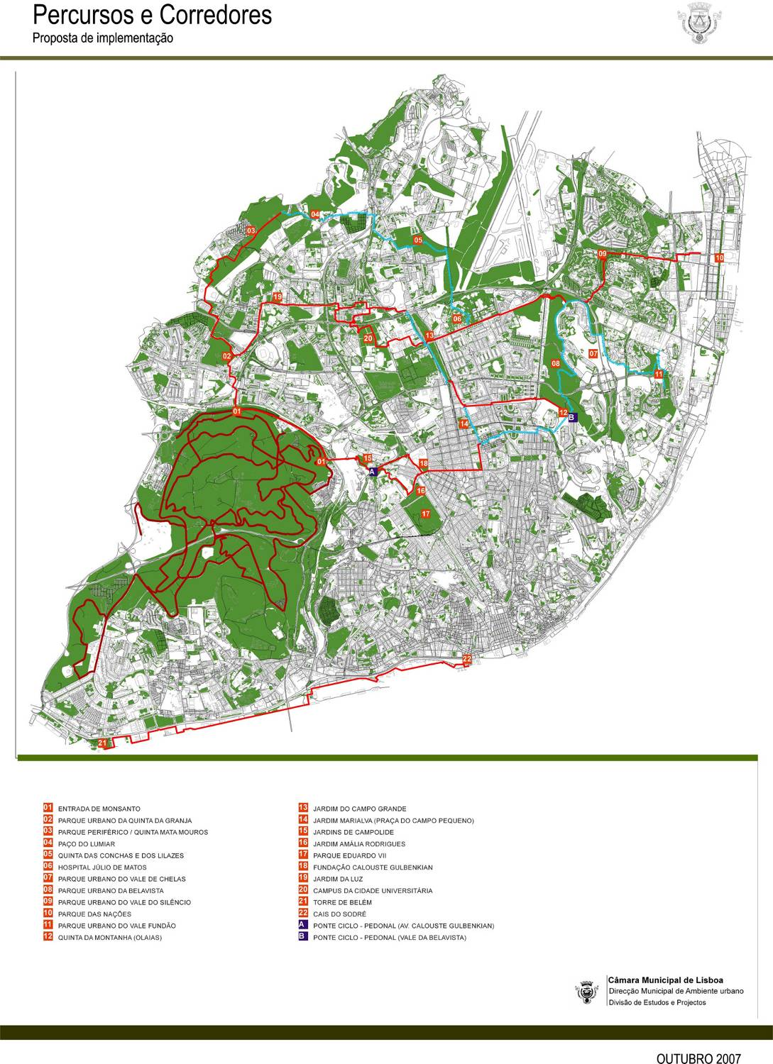
Allotment Gardens - A Valuable Ecosystem Service
pathways and corridors plan of the city of lisbon

Slide 33
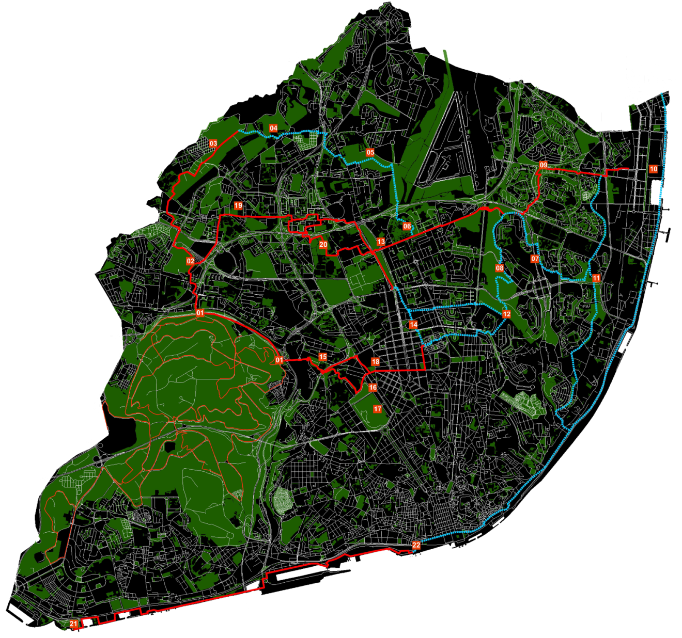
Allotment Gardens - A Valuable Ecosystem Service
key points of interest within the network path

